Slide 1

Project: G2M Insight For Cab Investment Firm
Data Science Internship Submitted by: Shubh Goyal Date: 19-April-2023

Slide 2

Outline
Problem Statement
Datasets Information
Exploratory Data Analysis
Multiple Hypothesis Test
Summary

Slide 3
Problem Statement
A private equity firm in the US, known as XYZ, intends to invest in the Cab industry due to the impressive growth it has experienced over the past few years, along with the presence of multiple key players in the market.
The primary goal of this venture is to assist the XYZ firm in selecting the most suitable company for investment by providing actionable insights.
To achieve this objective, the analysis has been categorized into four sections,
Data Understanding and Visualization,
Finding the Cab company with the largest user base,
Identifying the most affordable Cab company for users,
determining the most profitable Cab company.
Furthermore, various hypotheses will be developed and investigated to facilitate the decision-making process.

Slide 4

Data Information
The dataset provided for analysis comprises four files.
The first file, Cab_Data.csv, contains comprehensive information about transactions for two cab companies.
The second file, Customer_ID.csv, acts as a mapping table that associates each customer's demographic details with a unique identifier.
The third file, Transaction_ID.csv, is another mapping table that links each transaction to its respective customer and payment mode.
Finally, the fourth file, City.csv, contains a list of US cities, their population, and the number of cab users in each city.
These files serve as valuable resources for conducting the analysis on the cab industry investment opportunity for the XYZ private equity firm.

Slide 5
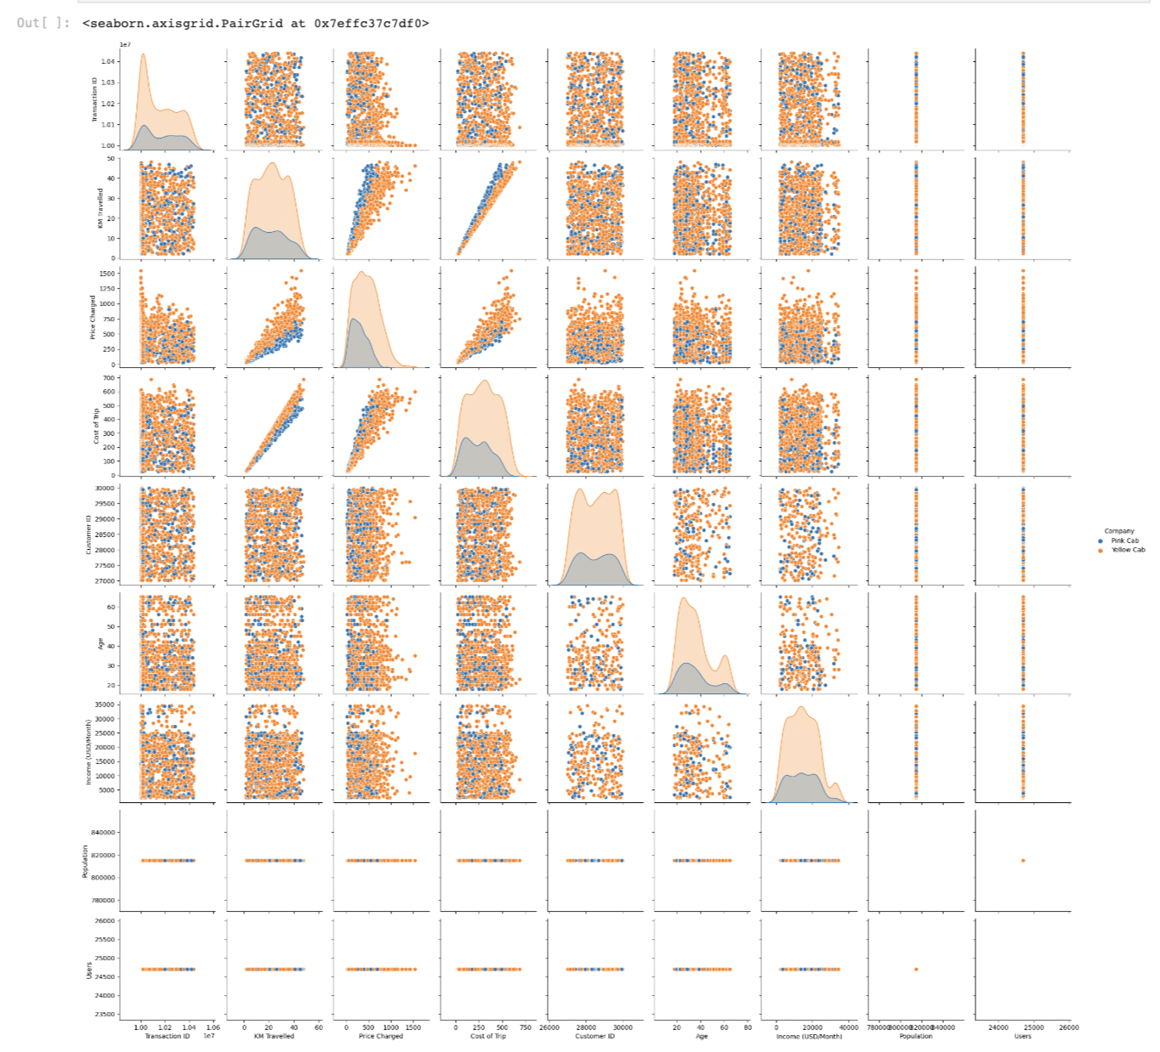
Relationships Between Variables

Slide 6
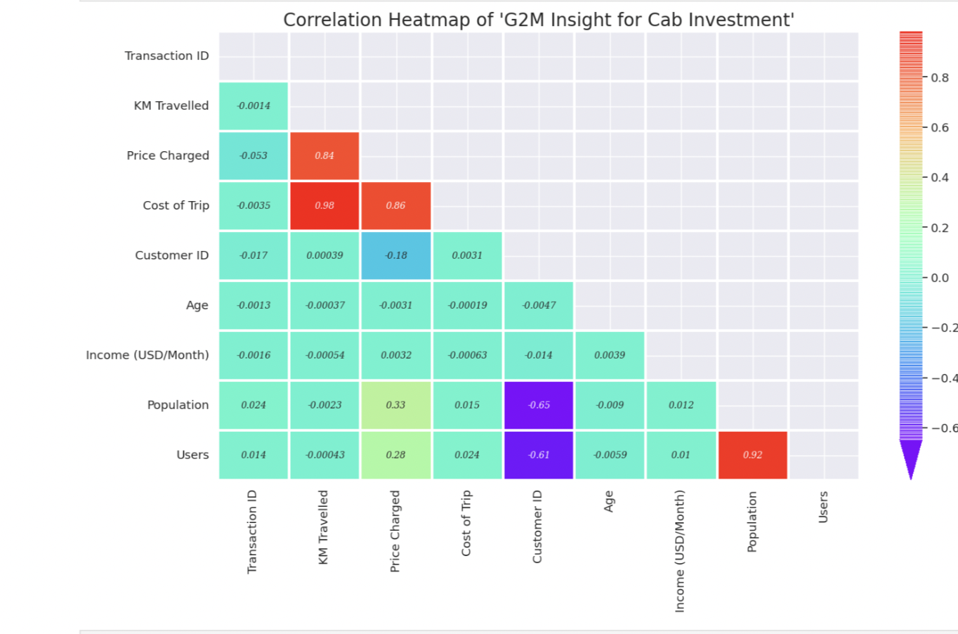
Correlation Between Variables
As we can see there is a strong correlation between
• Population vs Users
• Price Charged vs Cost of Trip vs KM Travelled

Slide 7
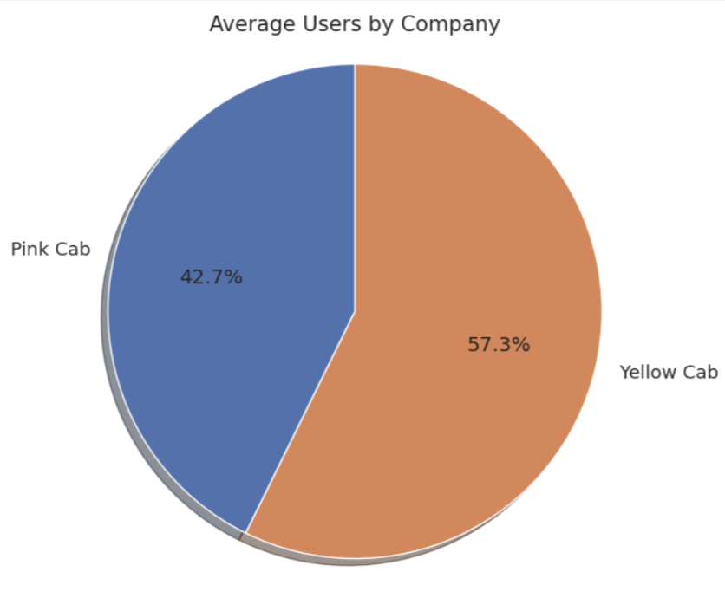
Which Company has more Users?
As we can see users like to ride on Yellow cab more as compared to Pink Cab

Slide 8
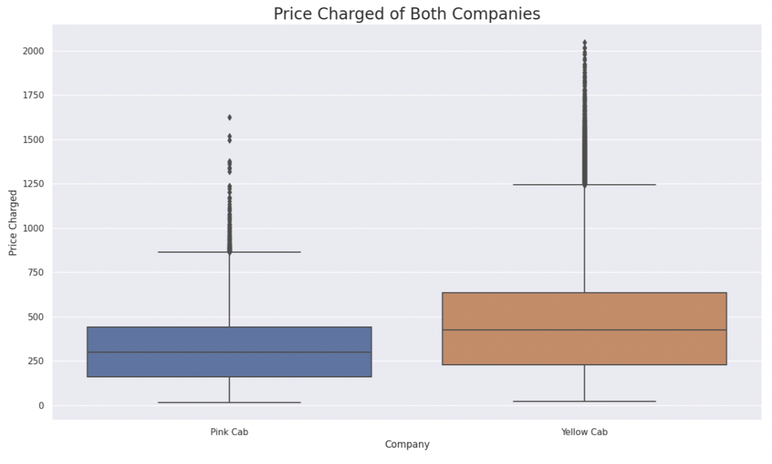
Which Company has a high price charged?
As we can see Price Charged for Yellow Cab is highest as compared to Pink Cab

Slide 9
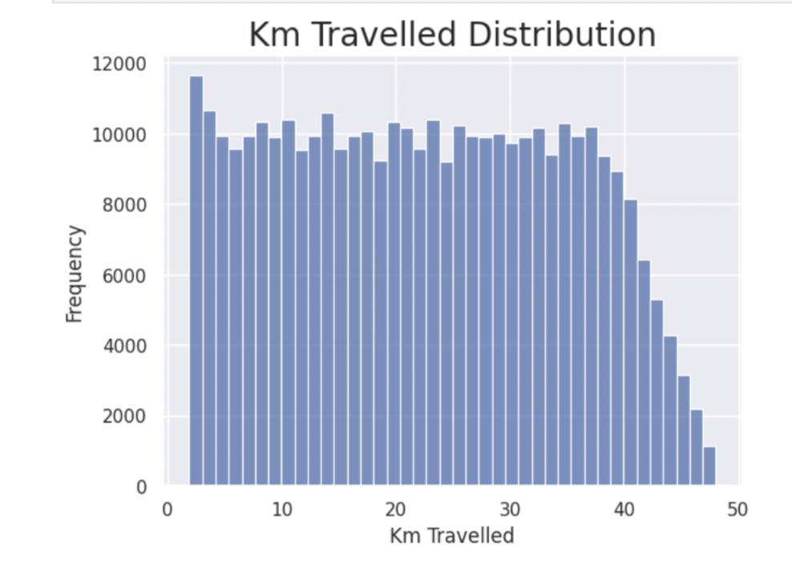
KM Travelled Distribution
Most of the rides varies from 2 to 48 KM.

Slide 10
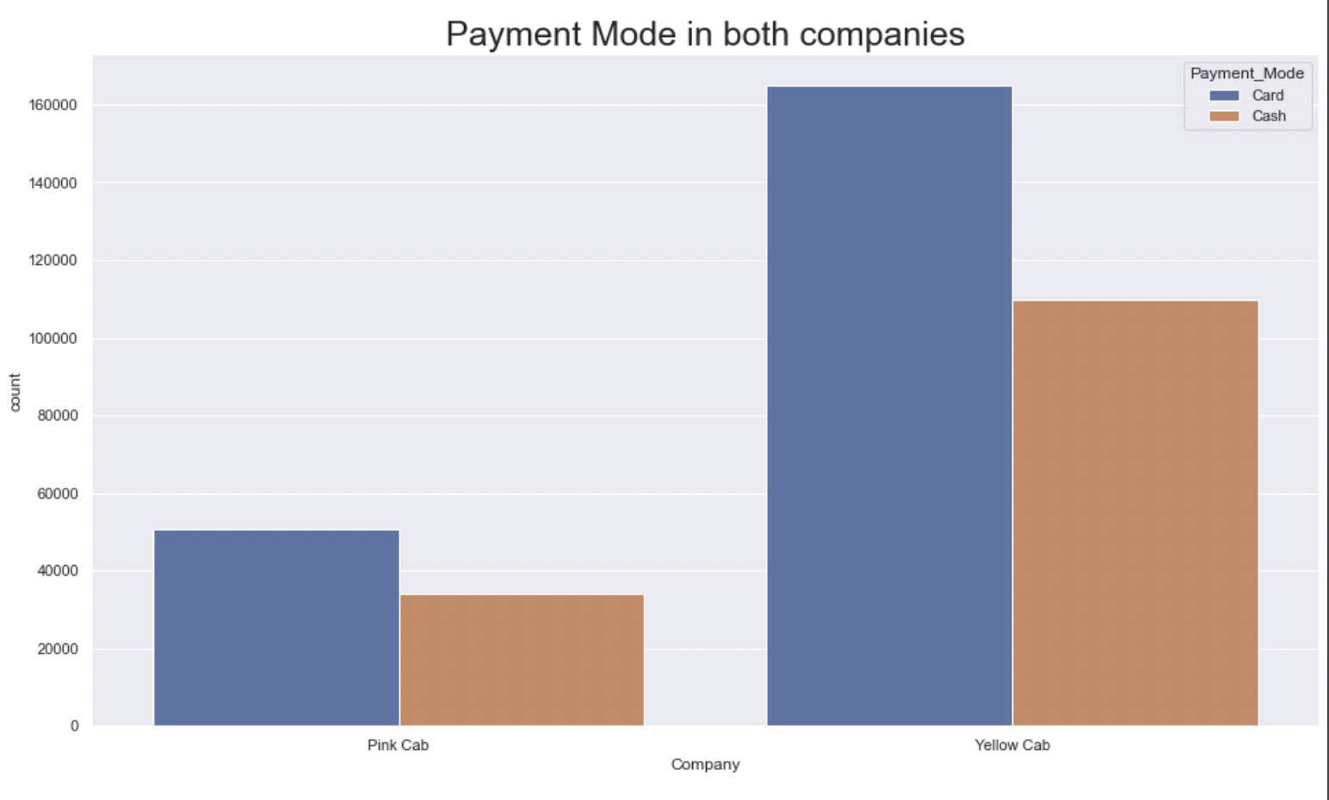
Payment Mode
As we can see that users prefer to pay with a card more compared to cash

Slide 11
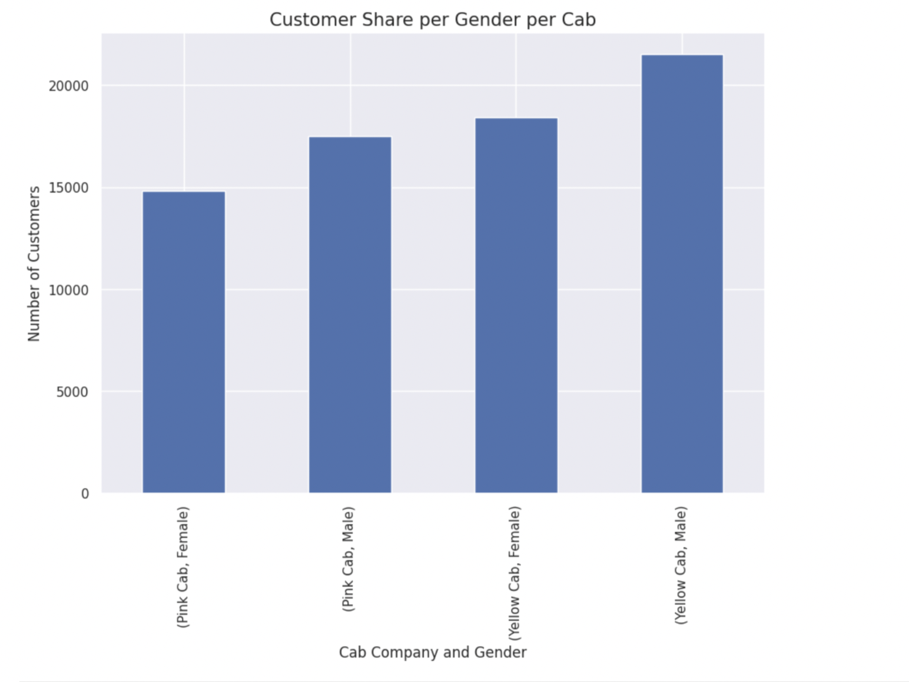
Users w.r.t Gender
• Male users prefer more to travel in Cab
• Users prefer to travel in Yellow Cab

Slide 12
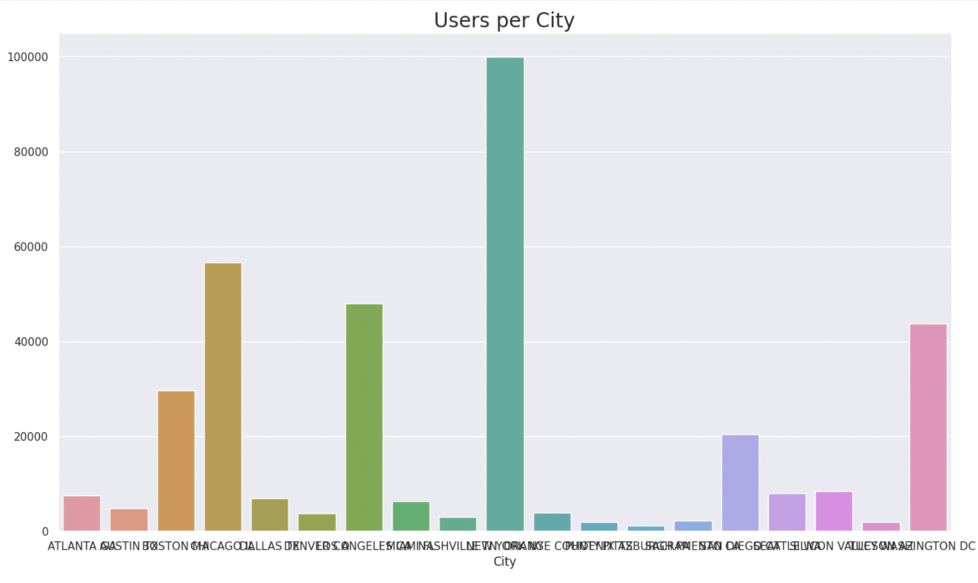
Users w.r.t Cities
New York City has the highest Cab users with 28% followed by Chicago with 16% and Los Angeles with 13%

Slide 13
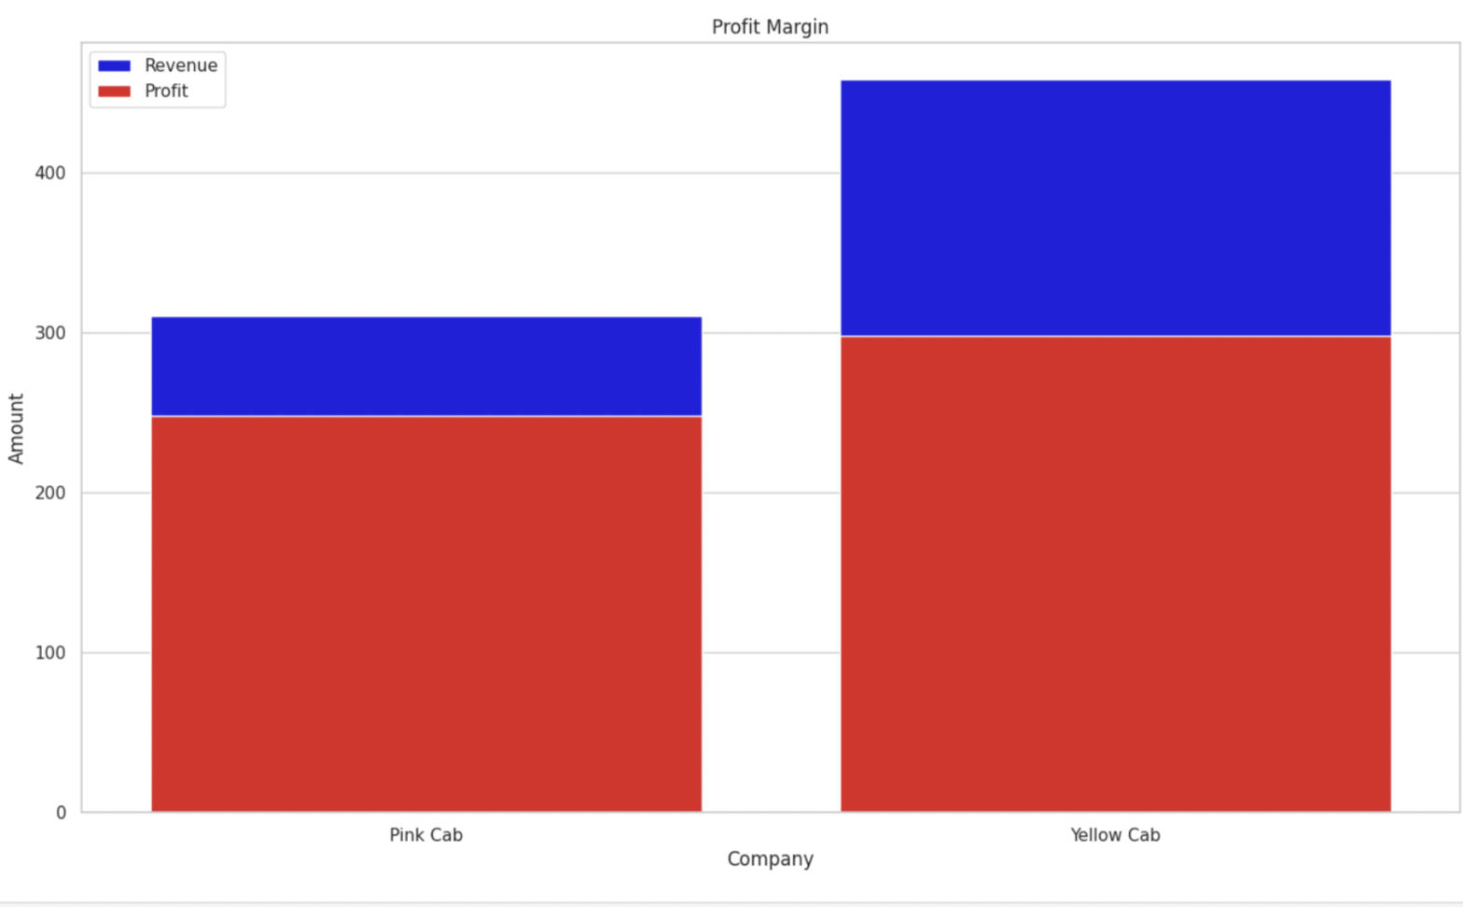
Profit Margin
• The Yellow cab has a higher Profit Margin (Price Charged - Cost of Trip) compared to Pink cab

Slide 14
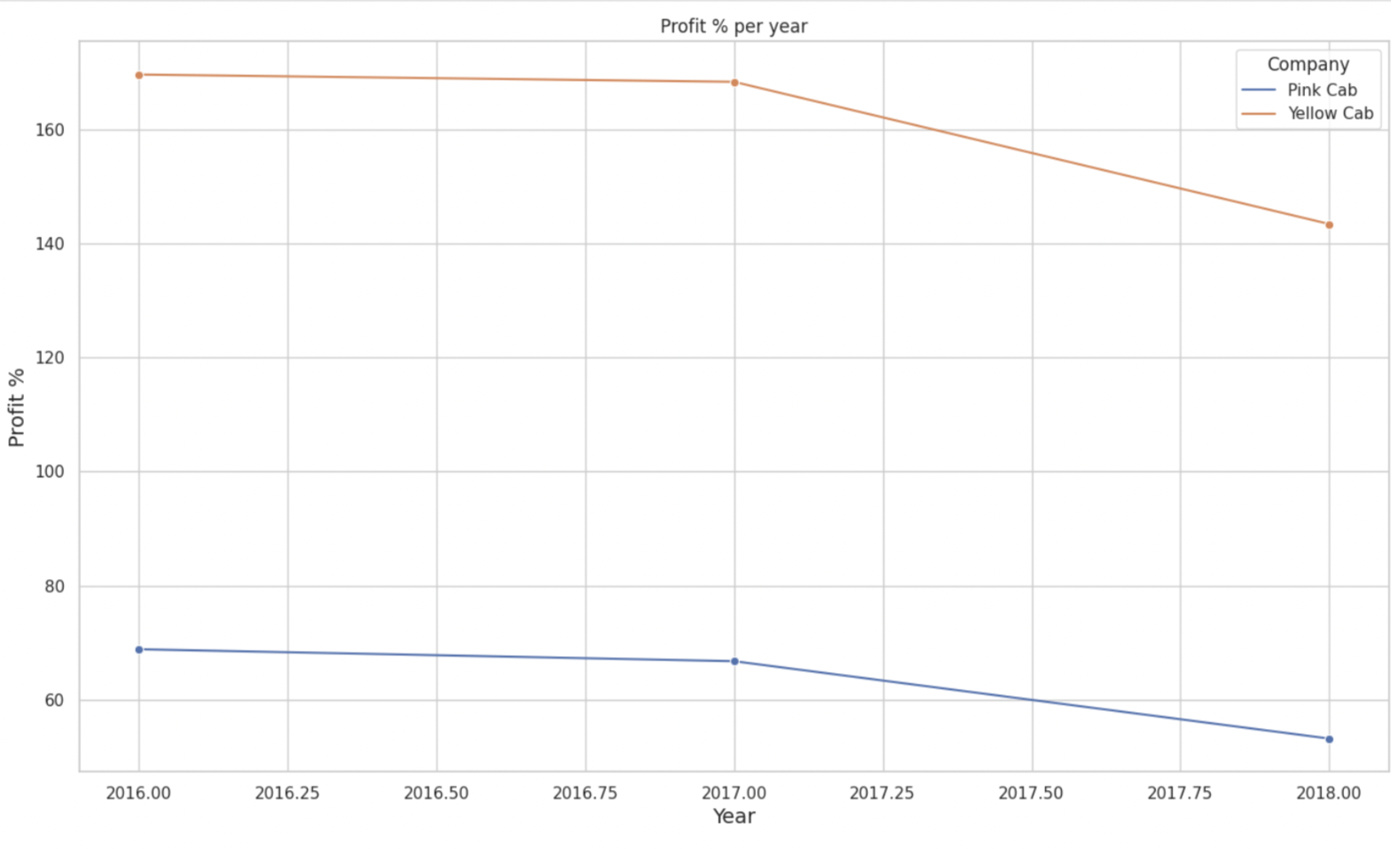
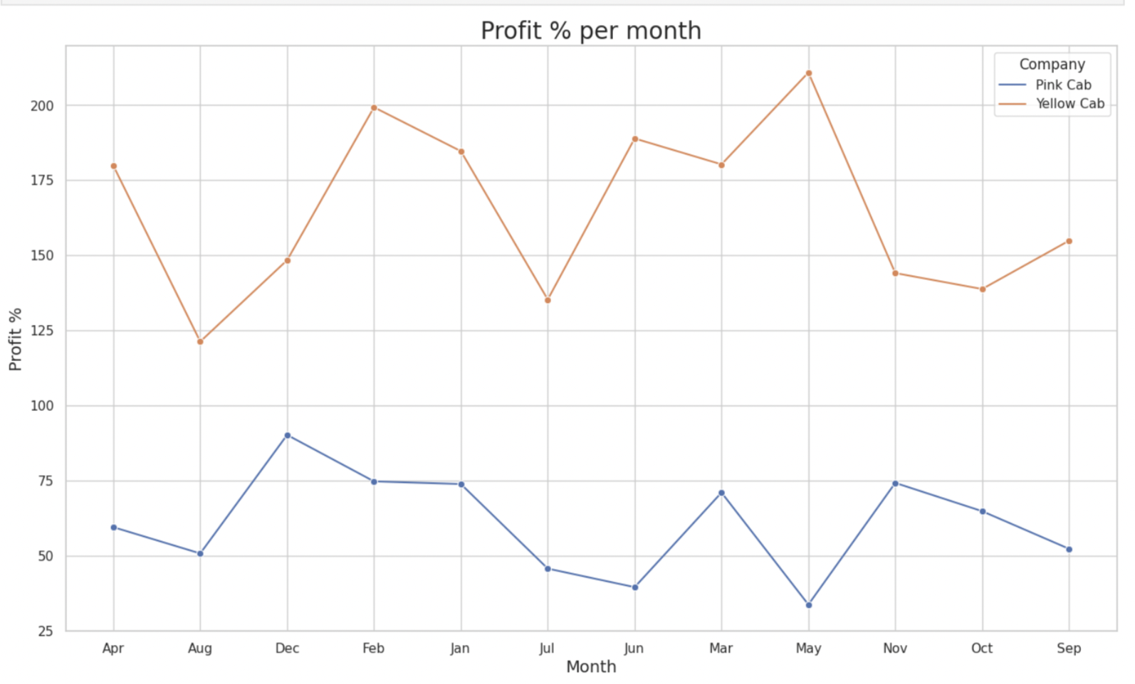
Profit Margin w.r.t Time
• The profit margin decreased w.r.t year
• The profit margin varies w.r.t month

Slide 15
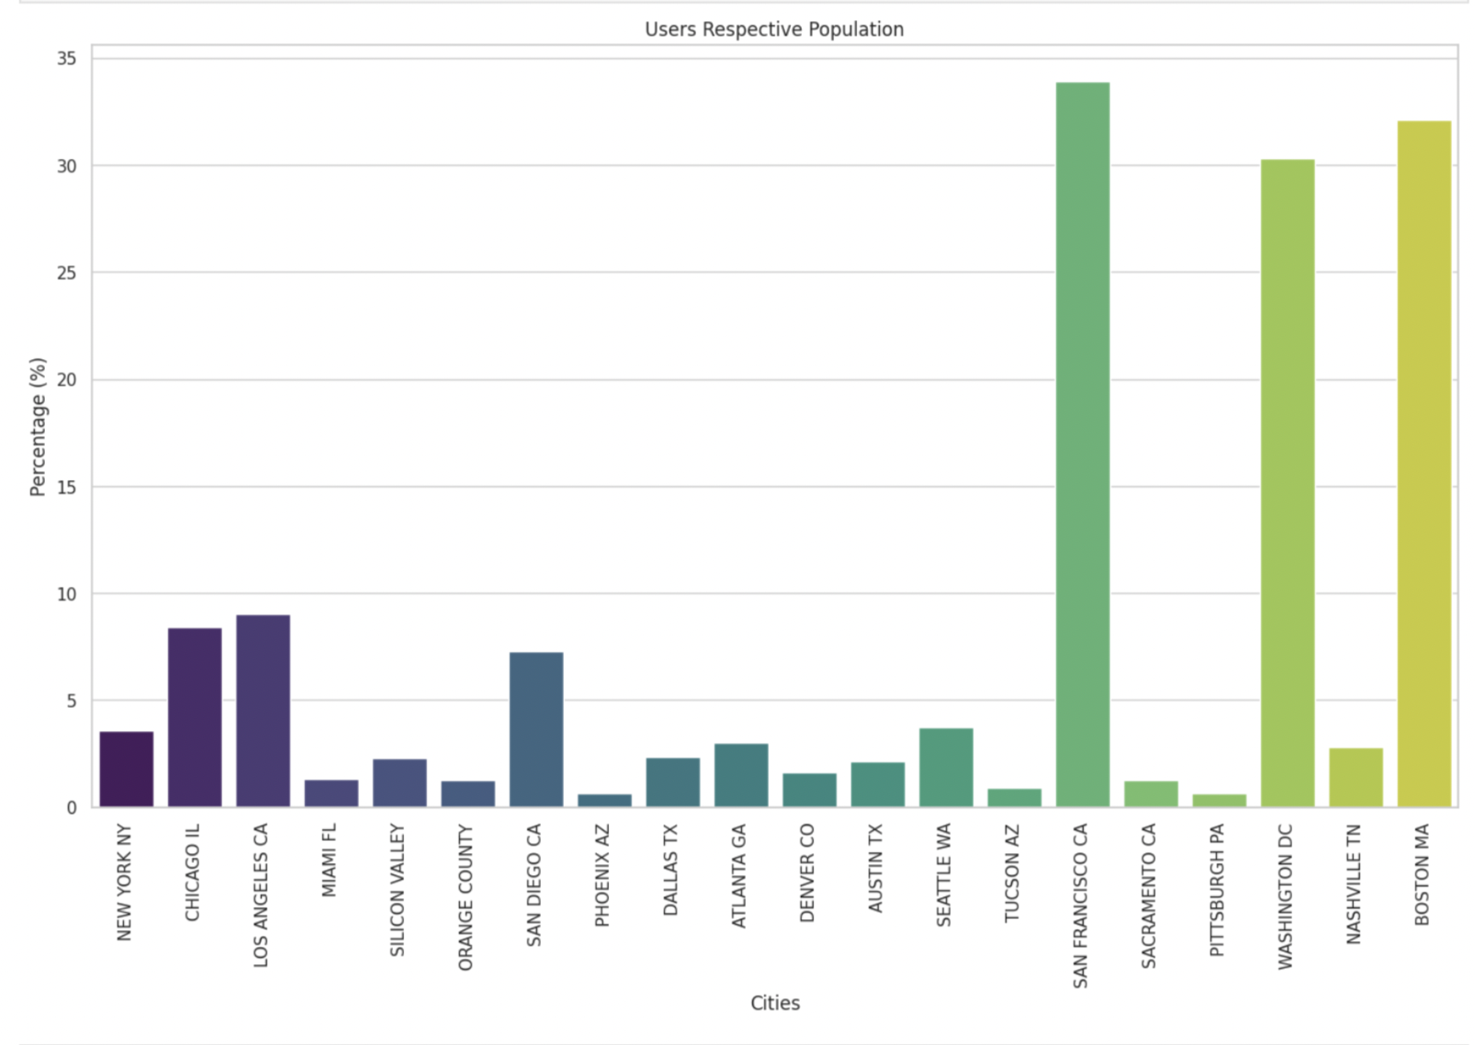
Users w.r.t Population
As we can see in the cities of San Francisco, Washington, and Boston more than 30% of the population use cab service

Slide 16
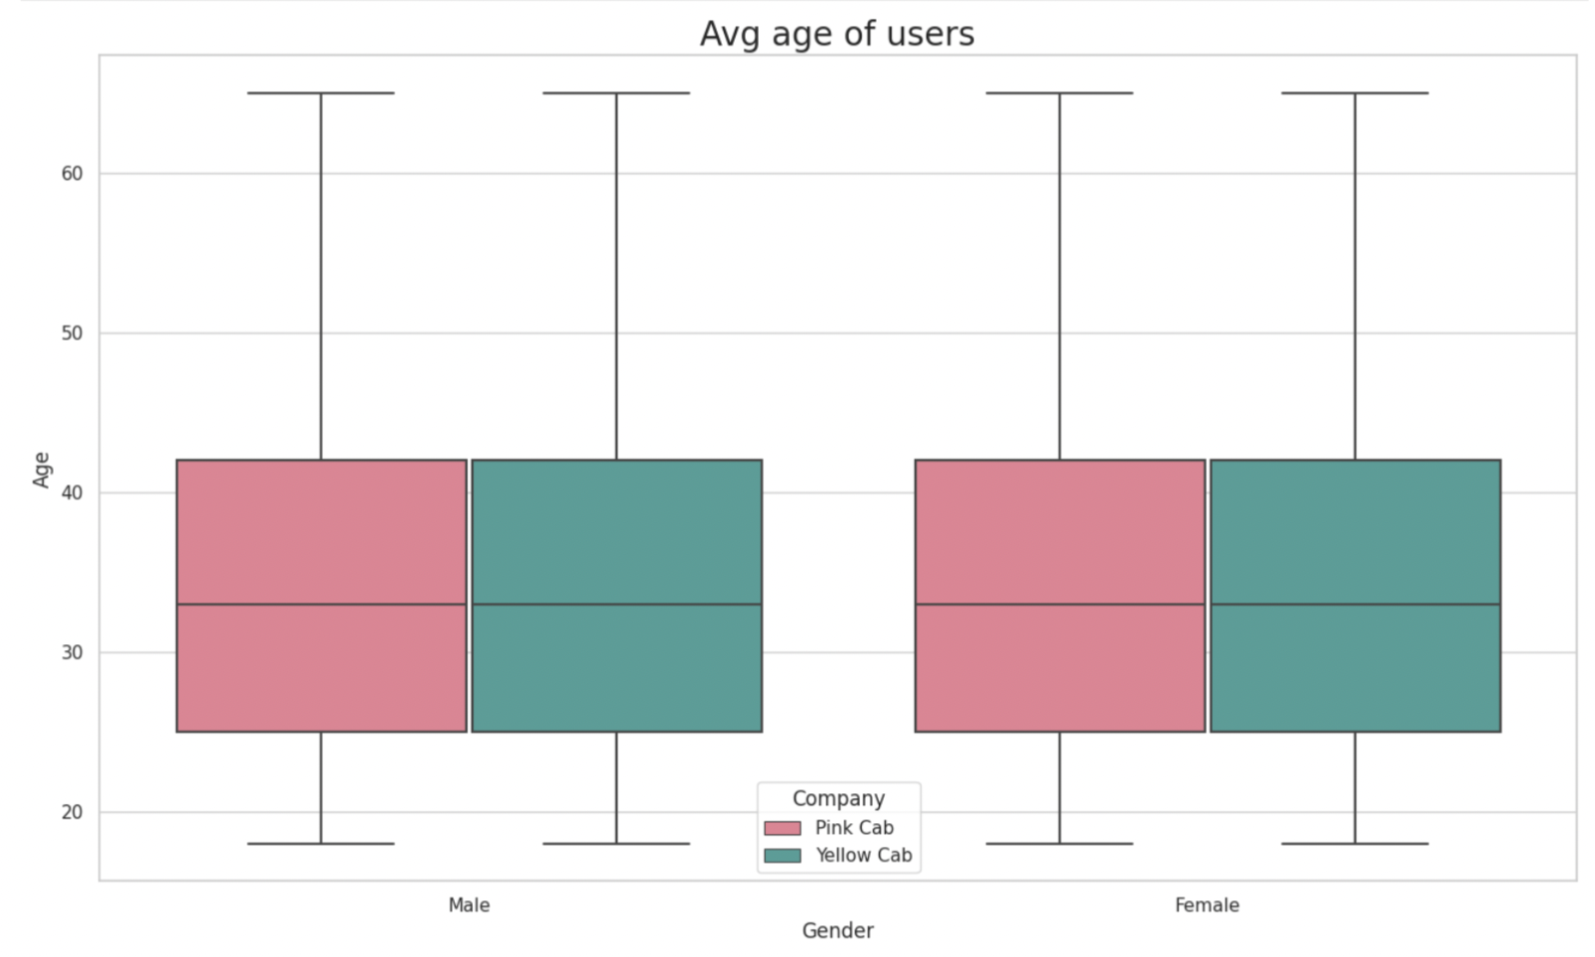
Average Age of Users
As we can see 35 Avg age of females and Male who use Cab service

Slide 17
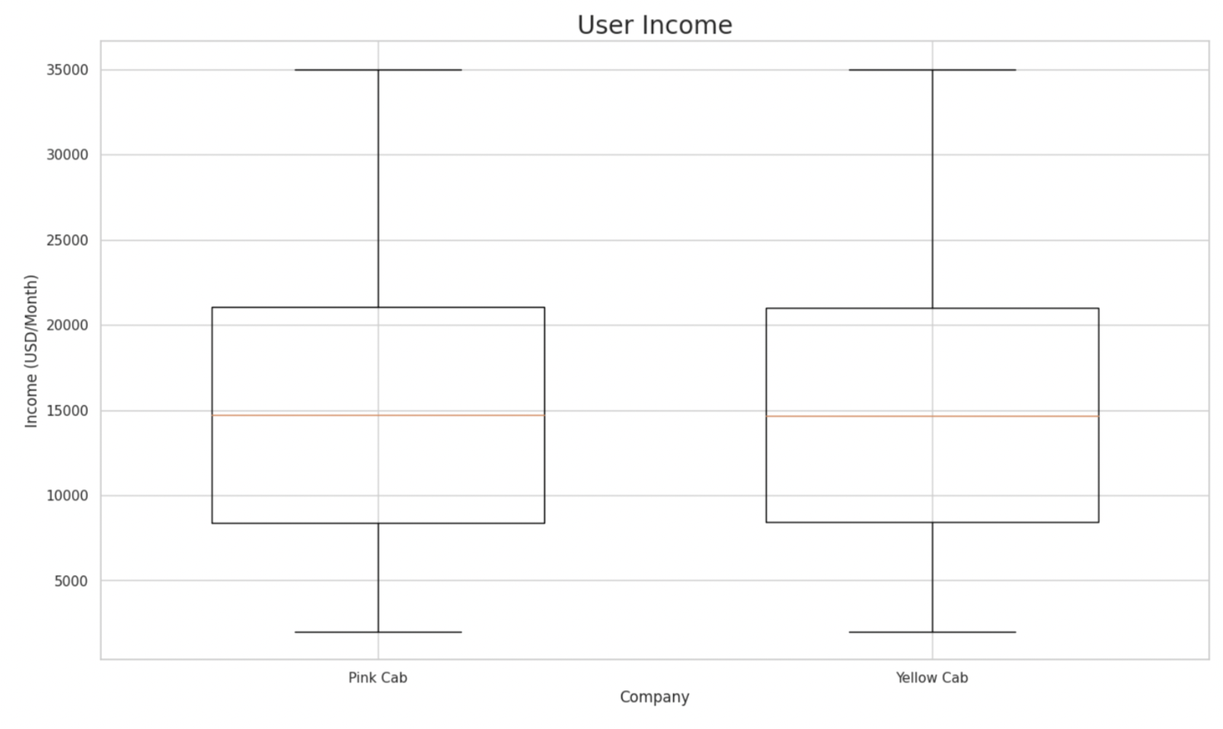
Average Income of Users
As we can see Avg income is around 15k$ who use cab service

Slide 18
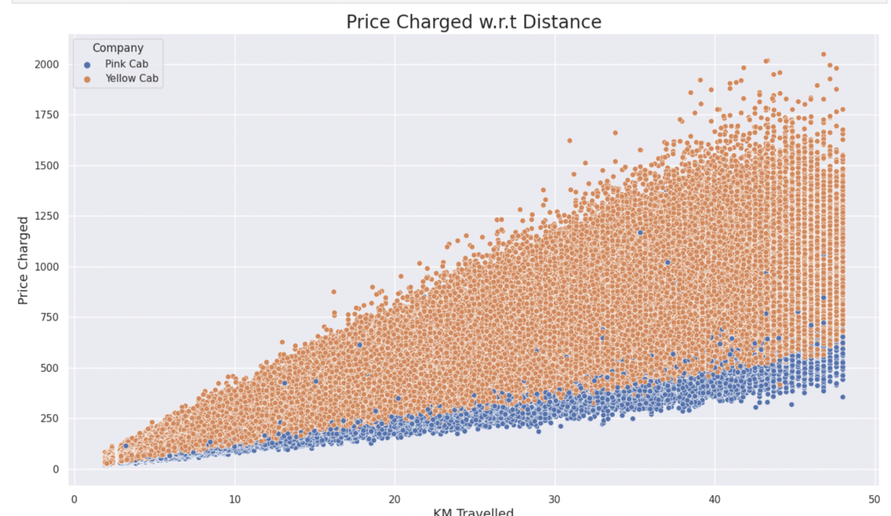
Price Charged w.r.t Distance
As we can see there is a linear relationship between KM traveled and Price Charged as we expected. However, Yellow Cab has high charges compared to Pink.

Slide 19
Hypothesis 1: Is there any difference in profit regarding Gender
H0: There is no difference regarding Gender in both cab companies.
H1: There is a difference regarding Gender in both cab companies.
Pink Cab Company
Yellow Cab Company
Conclusion
There is no difference regarding Gender in both cab companies

Slide 20
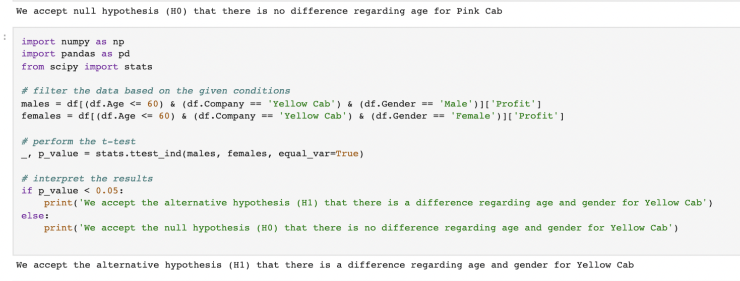
Hypothesis 2: Is there any difference in Profit regarding Age
H0: There is no difference regarding Age in both cab companies.
H1: There is a difference in Age in both cab companies.
Pink cab company
Yellow cab company
Conclusion
Looks like Yellow Cab company offers discounts for their customers who are older than 60 years old.

Slide 21
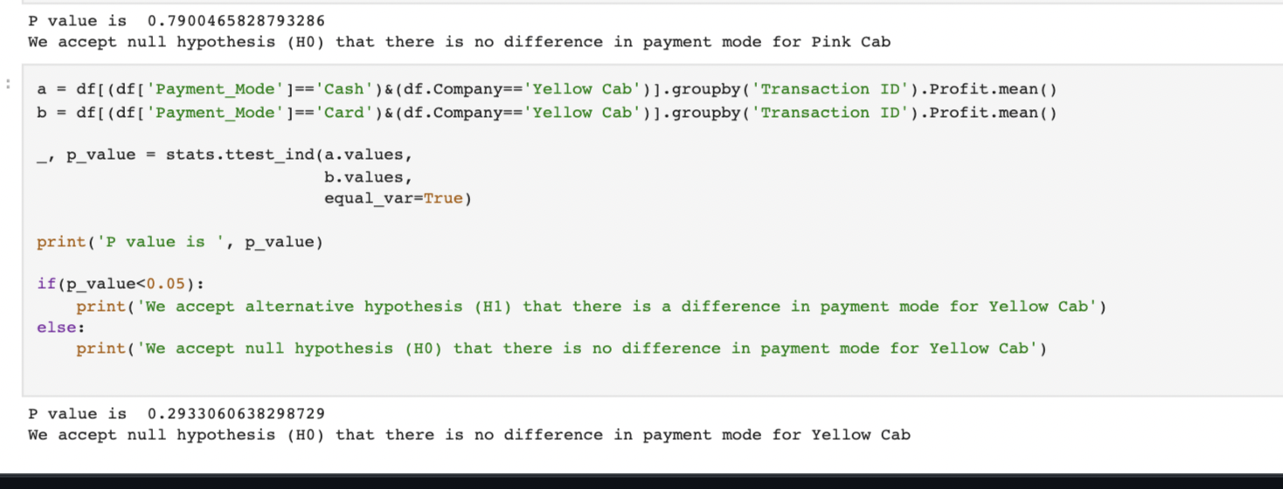
Hypothesis 3: Is there any difference in Profit regarding Payment mode
• H0: There is no difference regarding Payment Mode in both cab companies.
• H1: There is a difference regarding Payment Mode in both cab companies.
PINK CAB COMPANY
YELLOW CAB COMPANY
CONCLUSION
There is no difference in payment mode for both cab companies

Slide 22

Conclusion
Yellow Cab Company is better than Pink Cab Company Because:
Profit Margin
More Users
More transactions per Year

